Slide 1

PAGE 01
DETECT CHATGPT ANSWERS
ML OLYMPIAD
Amira MEJAAT (32009127)
Cheila LOPES TAVARES (32006548)
Marine MANDINA (32211029)
Ihsane BENYAHIA (32012909)
M2-MCI

Slide 2
PAGE 02
CLASSIFYING AI-GENERATED VS.
HUMAN RESPONSES
The dataset consists of prompts (questions) on various topics, including:
Opinion-based discussions
General knowledge inquiries
Scientific facts
Special cases for added complexity
Each prompt contains a mix of AI and human responses, but the ratio varies.

Slide 3


PAGE 03
MACHINE
1.
DATA IMPORT & PREPROCESSING
LEARNING
2.
DATA RESHAPING & FEATURE ENGINEERING
3.
TOKENIZATION & VECTORIZATION
4.
MODEL TRAINING & EVALUATION
5.
PREDICTION & FINAL RESULTS

Slide 4
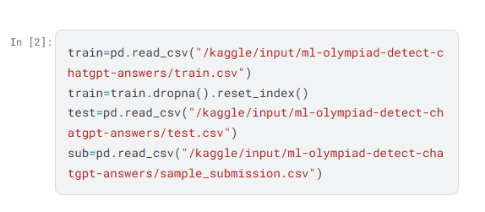

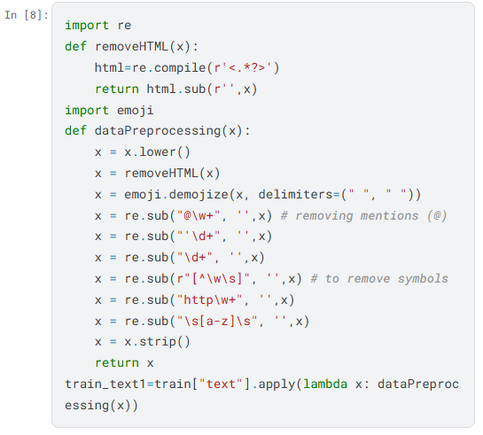
PAGE 04
DATA IMPORT &
PREPROCESSING
We received three dataset files from the competition organizers.
To process them, we use:
NumPy → for handling structured arrays and numerical operations
Pandas → for managing, filtering, and transforming tabular data
The dataset is split into:
✅ 80% for training the model (Train Set)
✅ 20% for testing the model (Test Set)
Before training, the dataset must be cleaned:
Use dropna() to remove rows with missing values and reset the index.
Further preprocessing ensures only complete responses are included.

Slide 5
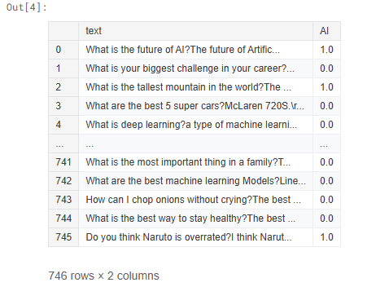

PAGE 05
DATA RESHAPING &
FEATURE ENGINEERING
To prepare the data for model training, we reshape it:
Create a new "text" column → combining the prompt and its response.
Add a target column → indicating whether the response is AI-generated (1) or human (0).

Slide 6
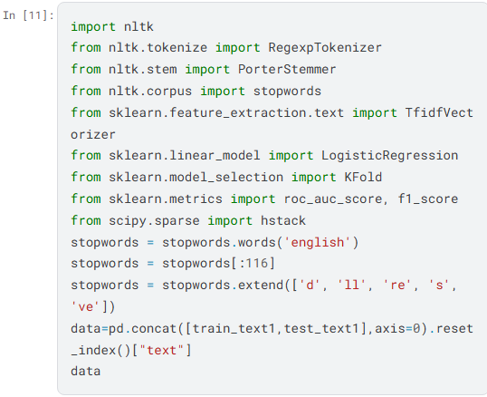

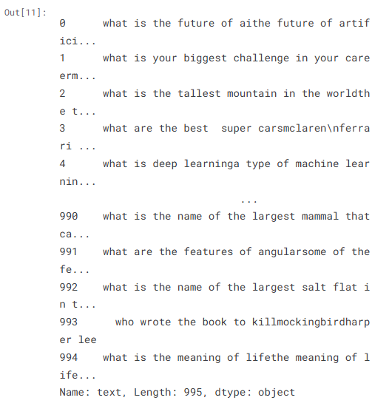
PAGE 06
TOKENIZATION
At this stage, we transform raw text into a format suitable for machine learning.
Tokenization is the process of Breaking Text into Smaller Units
Tokenization splits text into smaller parts (tokens) such as words or subwords.
This step is crucial in order to:
✔ Structured Data Requirement: ML models cannot process raw text directly.
✔ Captures Meaning & Context: Tokenization allows models to analyze relationships between words.
✔ Supports Multiple Languages & Writing Styles: Adapts to different linguistic structures.
✅Output of tokenization: X_train1 (Tokenized text) using NLTK (Natural Language Toolkit).

Slide 7

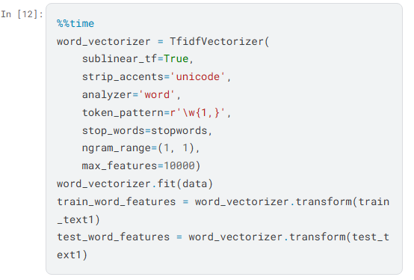
PAGE 07
VECTORIZATION
Once tokenized, text must be transformed into numbers (vectorization) so machine learning algorithms can process it.
Vectorization is important since :
Machine Learning Models Require Numbers: Text needs to be encoded into numerical form.
Preserves Structure & Meaning: Techniques like Bag of Words (BoW), TF-IDF, and Word Embeddings (Word2Vec, GloVe, BERT) capture word relationships.
Reduces Dimensionality: Efficient vectorization minimizes computational overhead.
✅Output of vectorization: X_train2 (Numerical representation of text)

Slide 8
PAGE 08
TOKENIZATION
&VECTORIZATION
X_train1 → Tokenized text (structured vertically)
X_train2 → Vectorized text (structured numerically)

Slide 9

MODEL TRAINING
PAGE 09
Steps in training:
Import data & our model
Split dataset into:
X_train → Processed text data
y_train → Target labels (AI = 1, Human = 0)
MODEL : TRANSFORMER-BASED MODEL (TORCH & ROBERTA)
1.
We train a model using PyTorch and Transformers
A BERT-based classifier (BertClass) is built for AI-human text classification
Results:
The model classifies ~200 responses as AI-generated.
It classifies ~500 responses as human-written.
Accurency score 69%
Train the model and make predictions.
Once our model is trained we can evaluate the performance using:
Error rate (R-squared score) → Measures prediction errors.
Cross-validation → Assesses model generalization

Slide 10
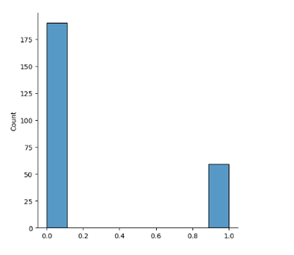
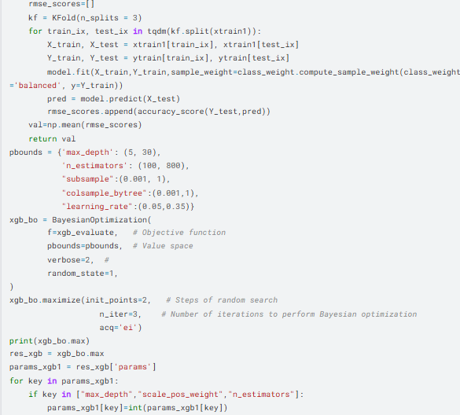
PAGE 10
MORE TRAINING MODELS
2.
MODEL : XGBOOST CLASSIFIER
Bayesian Optimization is used to optimize hyperparameters for the XGBoost classifier
Trainnig the model and make predictions.
The best target value achieved (optimized accuracy score) is 85%
About 60 answers were made from AI.

Slide 11
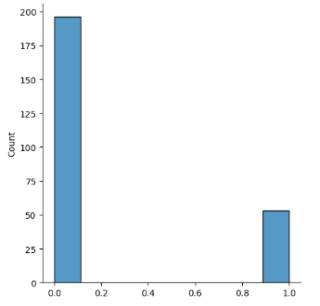
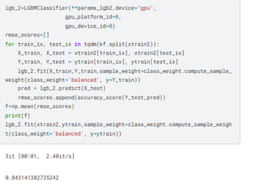
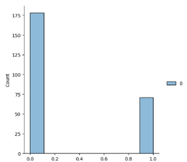
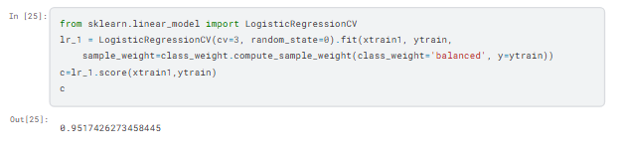
MORE TRAINING MODELS
PAGE 11
MODEL : LIGHTGBM CLASSIFIER (LGMC)
MODEL : CATBOOST CLASSIFIER
MODEL : LOGISTIC REGRESSION
3.
4.
5.
A LightGBM Classifier (LGMC) is trained using optimized data (X_train1).
BayesianOptimization
Achieved reliability score: 0.84
A LightGBM Classifier (LGMC) is trained using optimized data (X_train1).
BayesianOptimization
Achieved reliability score: 0.85
A Logistic Regression model is introduced for binary classification.
Achieved accuracy: 95%

Slide 12
PAGE 12
PREDICTION
& FINAL RESULTS
Multiple models are tested to ensure optimal performance.
The Model Linear Regression Achieved accuracy:
95% which is undeniably the best result.
About 190 answers are human-written; whereas about
60 are AI-generated answers.

Slide 13
EXAMPLE OF LINEAR REGRESSION MODEL FOR TEXT CLASSIFICATION
PAGE 13
Text | Word Count | Sentence Count | Coefficient | Label (0 = Human, 1 = ChatGPT)
T1 | 100 | 4 | 0.338 | 0
T2 | 250 | 10 | 0.846 | 1
T3 | 180 | 7 | 0.000 | 0
T4 | 300 | 12 | 1.015 | 1
T5 | 120 | 5 | 0.63 | ? (Model Prediction)

Slide 14

EXAMPLE OF LINEAR REGRESSION MODEL FOR TEXT CLASSIFICATION
PAGE 14
Text | Word Count | Sentence Count | Coefficient | Label (0 = Human, 1 = ChatGPT)
T1 | 100 | 4 | 0.338 | 0
T2 | 250 | 10 | 0.846 | 1
T3 | 180 | 7 | 0.000 | 0
T4 | 300 | 12 | 1.015 | 1
T5 | 120 | 5 | 0.63 | 1
Equation Determined by Model:
Y=0.004×(word count)+0.05×(sentence count)−0.1
Prediction for Text T5:
Y=0.004×120+0.05×5−0.1=0.63
Result:
Prediction = 0.63, indicating the text is most likely generated by ChatGPT.
Accuracy:
The model achieves a high accuracy of 95%.

Slide 15


PAGE 14
FINAL THOUGHTS &
CONCLUSION
This workflows show that it is pretty much simple to detect AI generating user and can be applied to real-world AI detection tasks, such as:
Identifying AI-written essays or articles
However we can wonder whether AI technology will advance so much in the coming year that the viability of these models will decline

Slide 16
PAGE 15
THANK
YOU!
Thank you for listenning !

